Slide 1
The Mechanics of the Ankle
Example 4
Milan S. Kovačević
Faculty of Science, Department of Physics
University of Kragujevac
Serbia
e-mails: kovac@kg.ac.rs
milan.kovacevic@pmf.kg.ac.rs
Foča, BiH, 2022.

Slide 2
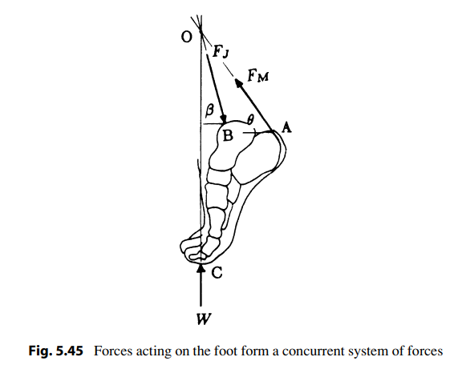
A person standing on tiptoe on one foot
Consider a person standing on tiptoe on one foot (a strenuous position illustrated). The forces acting on the foot during this instant are shown in Fig. 5.45
Foča, BiH, 2022.

Slide 3
Mechanical model - description
W is the person’s weight applied on the foot as the ground reaction force, F_{M} is the magnitude of the tensile force exerted by the gastrocnemius and soleus muscles on the calcaneus through the Achilles tendon, and F_{J} is the magnitude of the ankle joint reaction force applied by the tibia on the dome of the talus.
The weight of the foot is small compared to the weight of the body and is therefore ignored. The Achilles tendon is attached to the calcaneus at point A, the ankle joint center is located at point B, and the ground reaction force is applied on the foot at point C. For this position of the foot, it is estimated that the line of action of the tensile force in the Achilles tendon makes an angle θ with the horizontal, and the line of action of the ankle joint reaction force makes an angle β with the horizontal.
Foča, BiH, 2022.

Slide 4
The task
Assuming that the relative positions of points A, B, and C are known, determine expressions for the tension in the Achilles tendon and the magnitude of the reaction force at the ankle joint.
Foča, BiH, 2022.

Slide 5
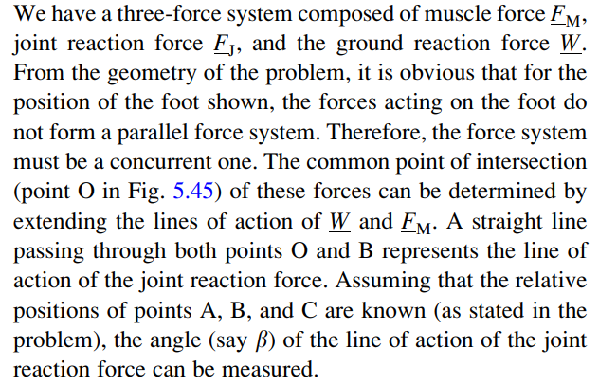
The solution
Foča, BiH, 2022.

Slide 6
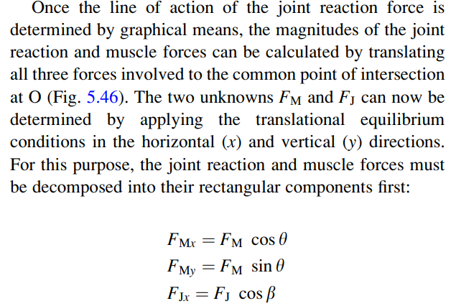
The Solution
Foča, BiH, 2022.

Slide 7
The Solution
Foča, BiH, 2022.

Slide 8
Thank you for your atention!
Dr Milan Kovačević, Full Professor
Faculty of Science, Department of Physics
University of Kragujevac
kovac@kg.ac.rs
milan.kovacevic@pmf.kg.ac.rs
Foča, BiH, 2022.

